Slide 1
Passenger Rate: Time Series Analysis
Sarah Foster, Kalvin Goode,Tony Khoury, Jia Ma, Timothy Nguyen, UCSB

Slide 2
Introduction
Passengers Rate for International Travel from January, 1949 to December 1960
Advantages of the time series model
Estimate Future Growth
Adjust Ticket Price
SARIMA model: SARIMA(3,1,1)X(1,1,0)₁₂
Least Amount of Parameters
Lowest AICc Score
Prediction made is within 95% confidence interval
Notes:
The objective of our project is to predict the number of monthly passenger rate for international travel. The data we taken from datamarket has interval between 1949 and 1960. To analyze data, we use times series model and technique. The model is useful to the airline company for two reasons. First, it can predict future rate within 95% confidence interval. Also, the airline industry can adjust price of the flight ticket according to the prediction of our model. Using time series analysis, we built an appropriate SARIMA model with the least amount of parameters and the lowest AIC score based on our stationary data. This stationary data was acquired through transforming and differencing our original data to eliminate its trend and seasonality. In addition, our model went through several diagnostic checks, and then forecast the number of international airline passengers for an entire year. After checking the validity, our predicted values are within a 95% confidence interval.

Slide 3
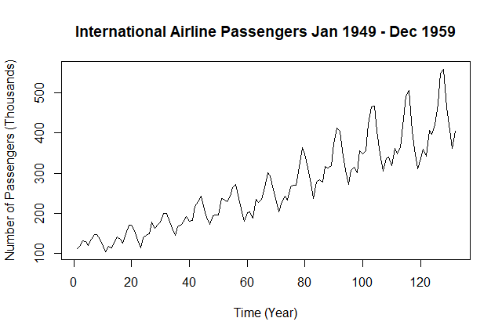
Exploratory Analysis
Dataset: Monthly total number of international airline passengers
January 1949 - December 1960
Sampling 144 observations
Testing 132 observations

Slide 4
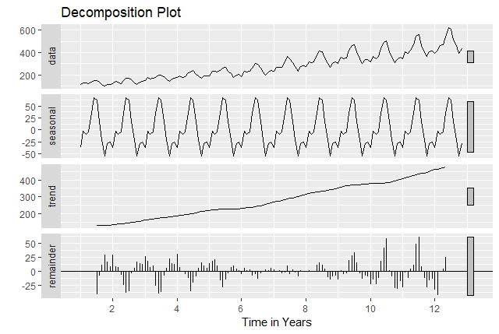
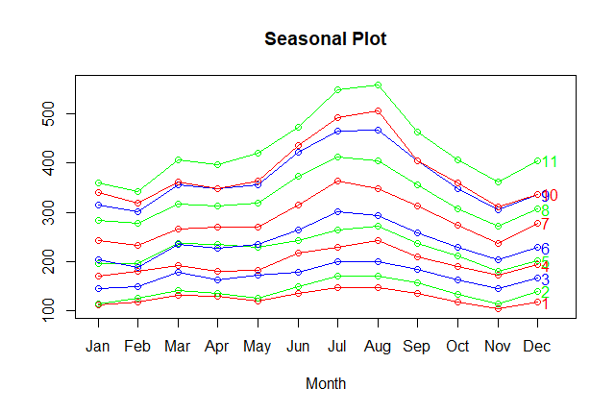
Exploratory Analysis
Check for stationarity:
Seasonal Plot
Decomposition Plot

Slide 5
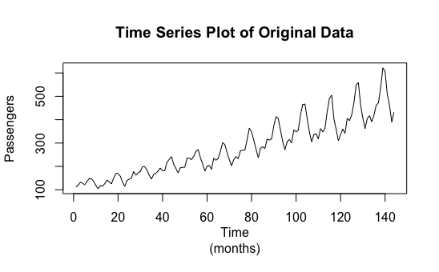
Data Transformation

Slide 6
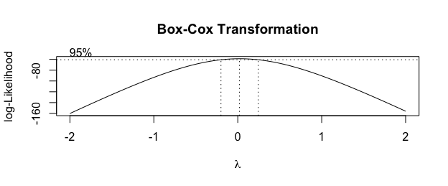
Data Transformation (cont.)

Slide 7
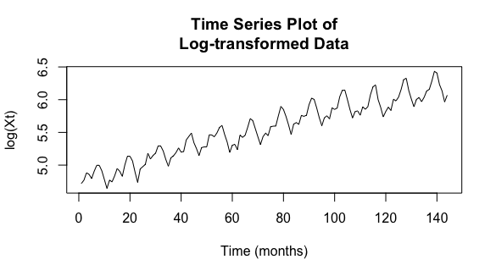
Data Transformation (cont.)
Var(log(Xt)) = 0.1948838

Slide 8
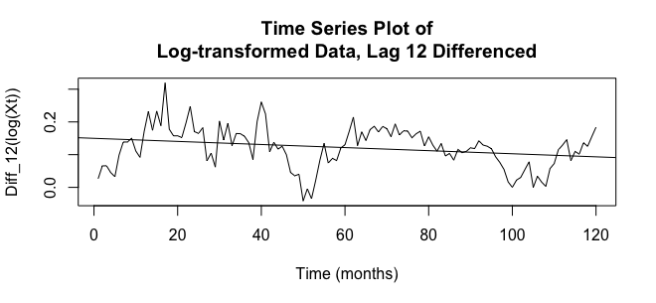
Data Transformation (cont.)
Var(Diff_12(log(Xt)) = 0.004036354

Slide 9
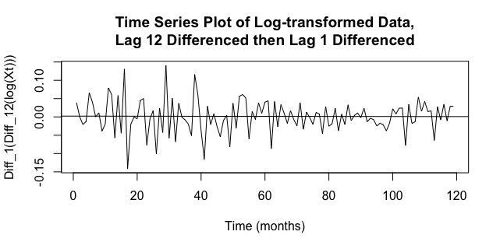
Data Transformation (cont.)
Var(Diff_1(Diff_12(log(Xt))) = 0.002028451
Var(Diff_1(Diff_1(Diff_12(log(Xt)))) = 0.005370351

Slide 10
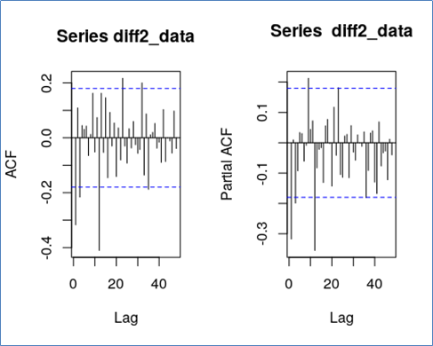
Model Identification
General SARIMA model:
SARIMA (p, d, q) x (P, D, Q)_{s}
From our data, we know S = 12, d = D =1
Seasonal ACF and PACF plots
Our ACF plot cuts off at lag 12 ( Q = 1)
and our PACF plot cuts off after lag 1
( P = 1)

Slide 11
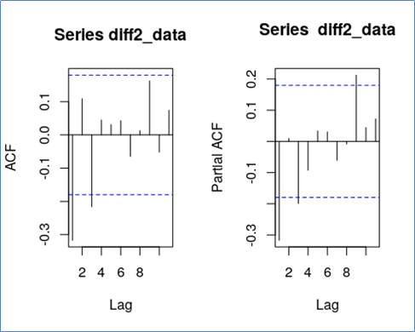
Model Identification (cont.)
Non-seasonal ACF and PACF plots
max(p, q) = 3
p and q can be values between 0 and 3
16 possible models

Slide 12
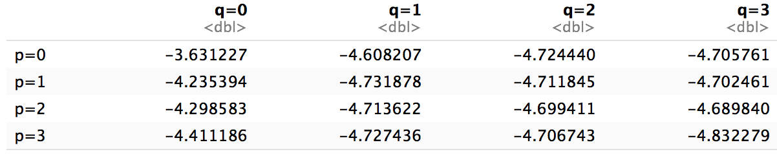
Model Selection
Smallest AIC comes from the model with p = q = 3, dismiss it by principle of parsimony
The next 3 models with lowest AIC values are p = q = 1, p =3 q =1, p = 0 q=2, respectively.
SARIMA (1, 1, 1 ) x (1, 1, 0)₁₂, SARIMA (3, 1, 1 ) x (1, 1, 0)₁₂ and
SARIMA (0, 1, 2 ) x (1, 1, 0)₁₂.
Note: models selected use Q = 0 instead of Q = 1. This is because any model we tried with Q = 1 resulted in a unit root.

Slide 13
Model Estimation
Estimation using MLE method; model 2 is our best model.
Model 1 : SARIMA (1, 1, 1 ) x (1, 1, 0)₁₂
(1 − 0.3499B)(1 − 0.0721B¹²)Xt = (1 − 0.999B)Zt,
where Zt ∼N (0, 0.003021)
Model 2 : SARIMA (3, 1, 1 ) x (1, 1, 0)₁₂
(1 − 0.3634B - 0.0921B² - 0.2173B³)(1 + 0.0731B¹²)Xt = (1+0.9703B)Zt,
where Zt ∼N (0, 0.002925)
Model 3 : SARIMA (0, 1, 2 ) x (1, 1, 0)₁₂
(1 + 0.6827B¹²)Xt = (1+1.3714B - 0.3856B²)Zt,
where Zt ∼N (0, 0.003044)

Slide 14
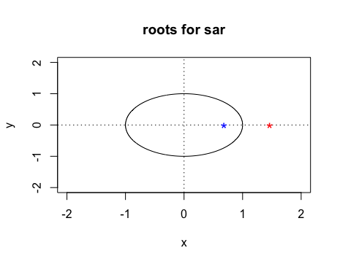
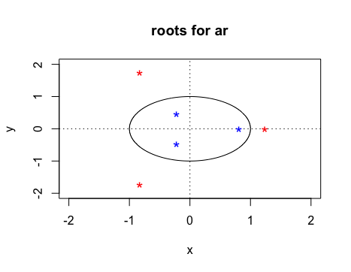
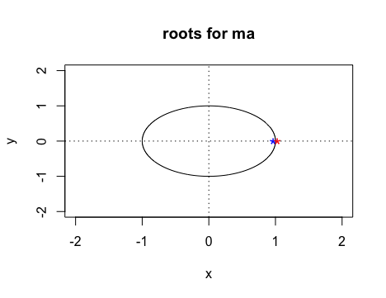
Model Estimation

Slide 15
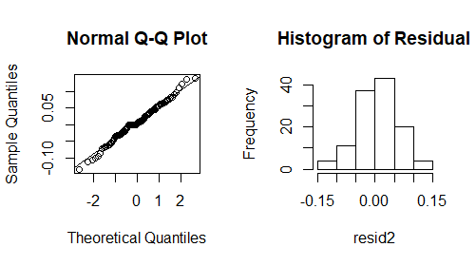
Model Diagnostics
Normality of Error
Normal Q-Q Plot
Histogram
Shapiro-Wilk Test
p-value = 0.5609

Slide 16
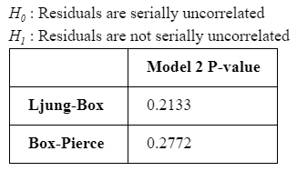
Model Diagnostics
Serial Correlation
Goal: No correlation between residuals
Ljung-Box Test
Box-Pierce Test

Slide 17
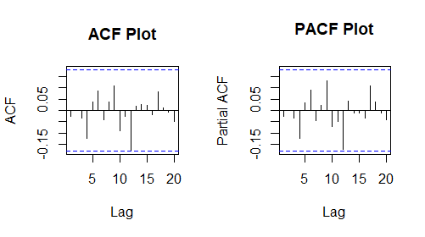
Model Diagnostics
Heteroskedasticity
Violation of constant error variance assumption
Goal: constant variance
ACF/PACF Plot
Final Model:
SARIMA (3, 1, 1 ) x (1, 1, 0)₁₂
(1 − 0.3634B - 0.0921B² - 0.2173B³)(1 + 0.0731B¹²)Xt = (1+0.9703B)Zt,
where Zt ∼N (0, 0.002925)

Slide 18
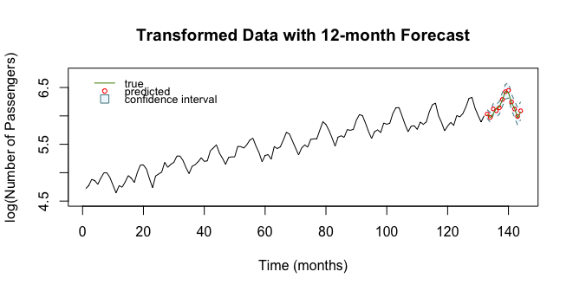
Forecasting

Slide 19
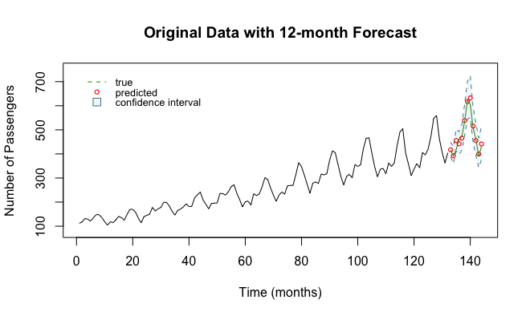
Forecasting (cont.)

Slide 20
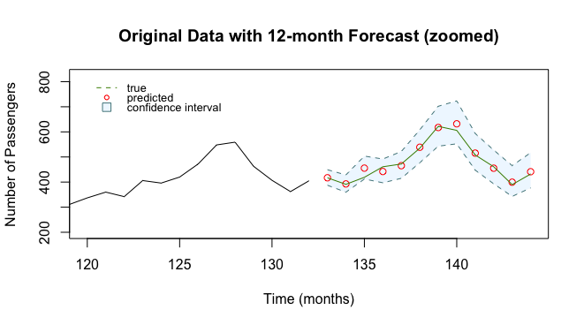
Forecasting (cont.)
Model captures seasonality and trend
True values all fall within 95% CI
Highest deviation: 36.55 passengers (8.72%) from ground truth
Mean deviation: 10.86 passengers (2.31%) from ground truth

Slide 21
Future Study
Model Limitations
Unexpected events can disrupt seasonality
Model does not account for these unexpected events
Current Model
Highly accurate forecast of last 12 months
Highly accurate overall if there are no disruptions in seasonality and current trend
Provides valuable information for international airlines
Model Improvement
Larger sample
Model for domestic airlines or specific airlines

Slide 22
Conclusion
Upward trend: increase in US population
Seasonality component: more international airline passengers in the summer
Log transformation and differencing the data gives us: X_{t} = ∇∇₁₂ log(Y)
Family travel
Final Model : SARIMA (3, 1, 1 ) x (1, 1, 0)₁₂
(1 − 0.3634B - 0.0921B² - 0.2173B³)(1 + 0.0731B¹²)Xt = (1+0.9703B)Zt,
where Zt ∼N (0, 0.002925)
True data points from the year 1960 lie within 95% confidence interval so we conclude we
picked a good model.

